Slide 1
ENVIRONMENTAL SURVEY OBJECTIVES
The main aims of this assessment are to:
Gain an understanding of the total area of vegetation impacted/removed in the vicinity of rock-climbing sites.
Document the nature of other disturbances (other than vegetation removal) at rock-climbing sites.

Slide 2
SITE SELECTION
Site selection was made in consultation with local staff.
It was primarily based on sites which:
offered a wide geographic spread (across north, central and south)
mix of SPAs and non-SPAs
a range of climbing types and
different degrees of use
The sites were also chosen based on observations of new and emerging use and predicted increases in future use based on current climbing restrictions.

Slide 3
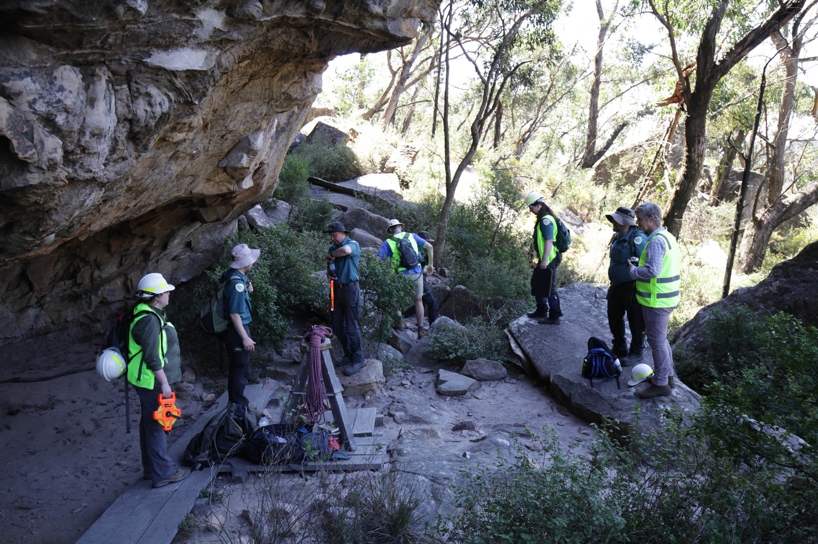

Slide 4
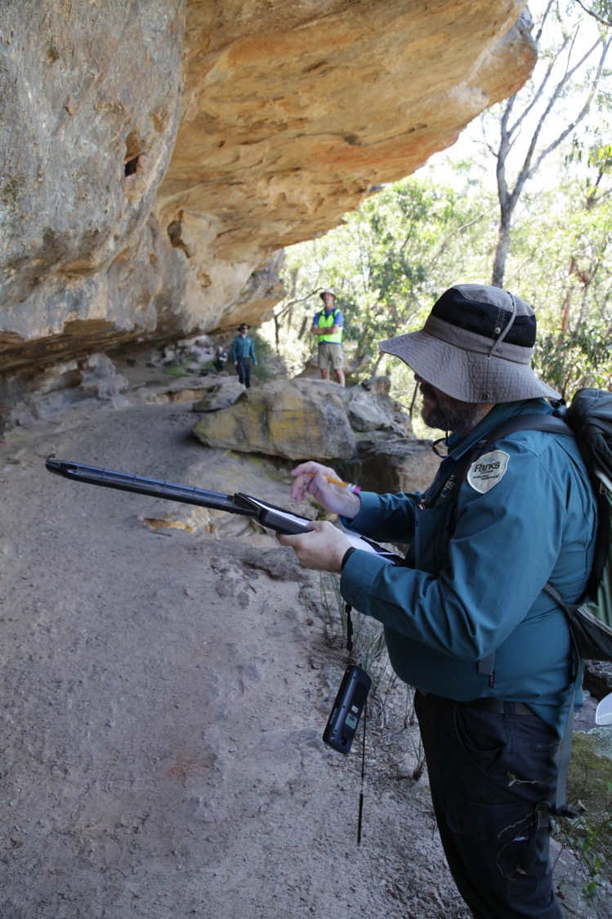

Slide 5
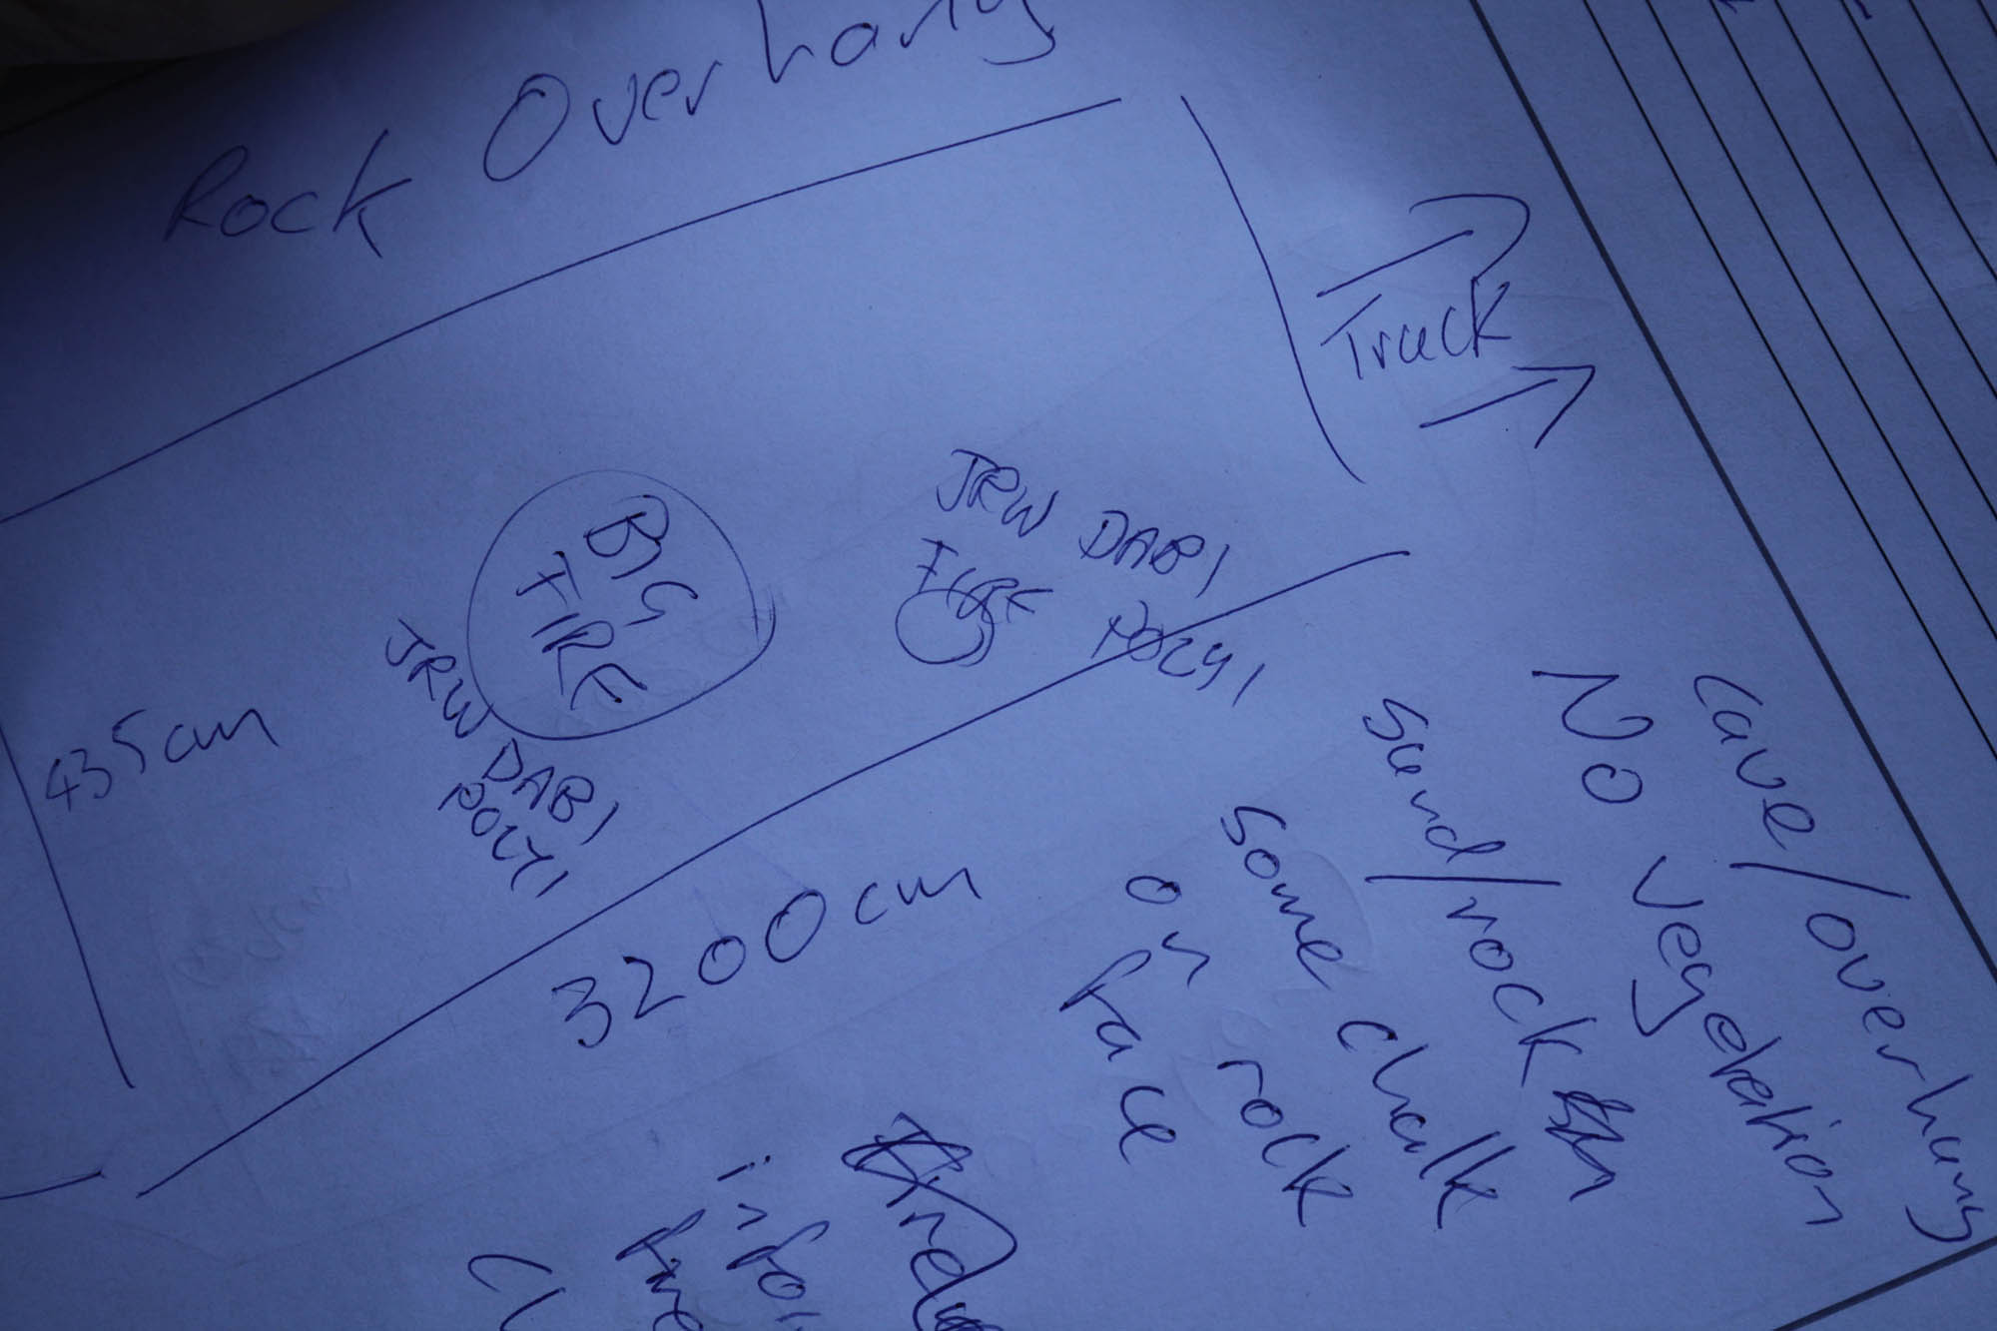

Slide 6
The main impacts assessed were:
Vegetation clearance/loss - VL
Formation of side tracks - ST
Evidence of constructed fires - FS
Toilet waste – TW
General rubbish – RU
Evidence of cinnamon fungus - PC
Cut stump - CS
Weeds – WE
Rock works and cairns – CN
Climbing equipment – CE
Camping equipment – CAE
Evidence of climbing activity – CA
Evidence of bouldering – BO

Slide 7
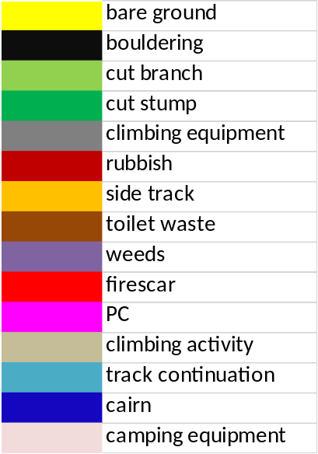

Slide 8
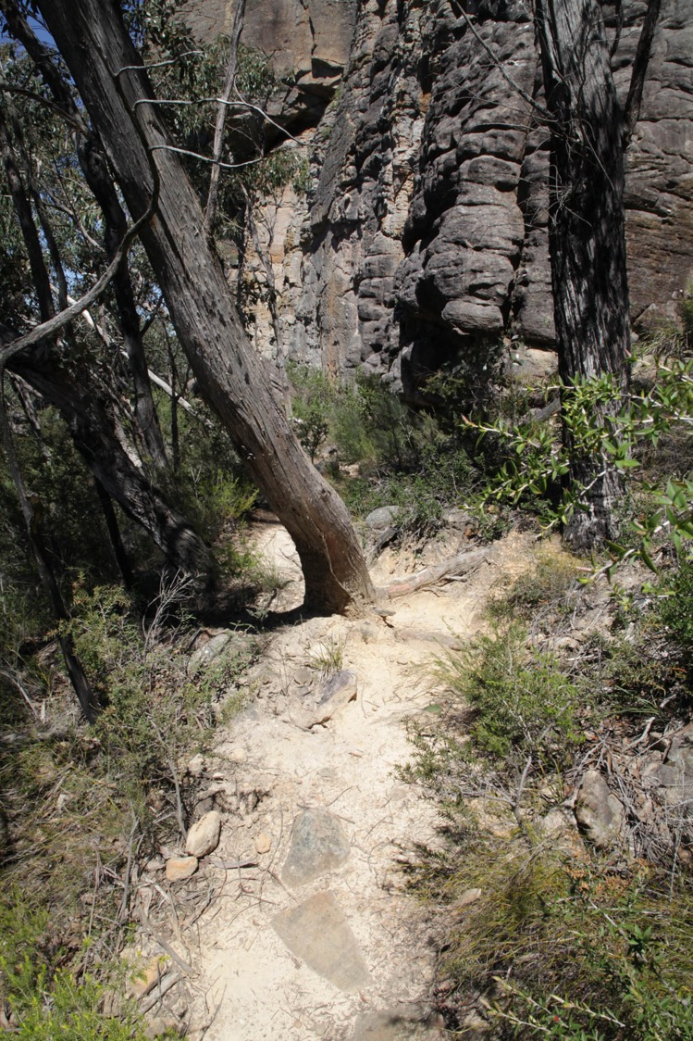
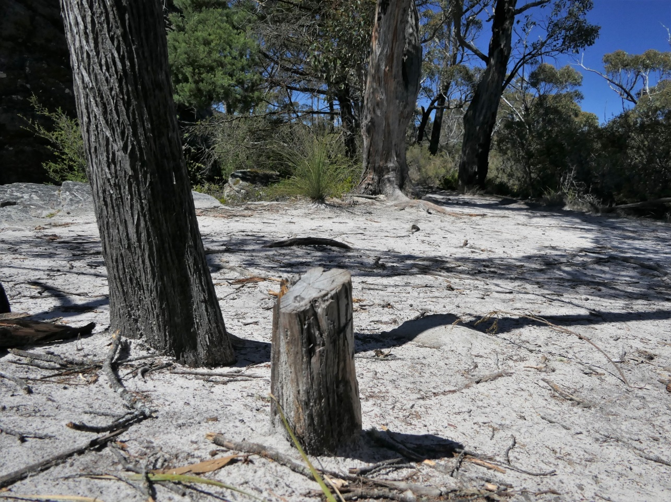
Vegetation clearance and sidetracks

Slide 9
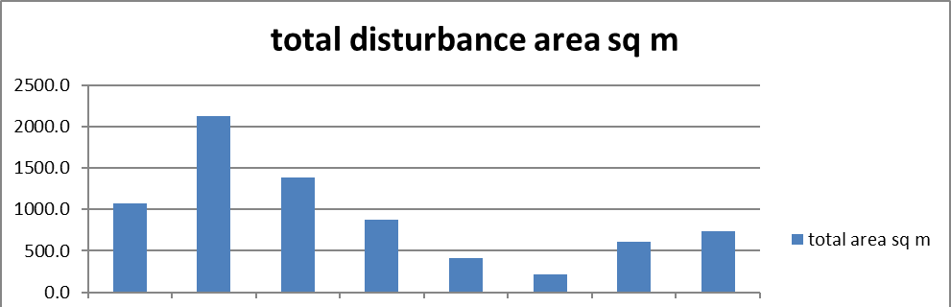
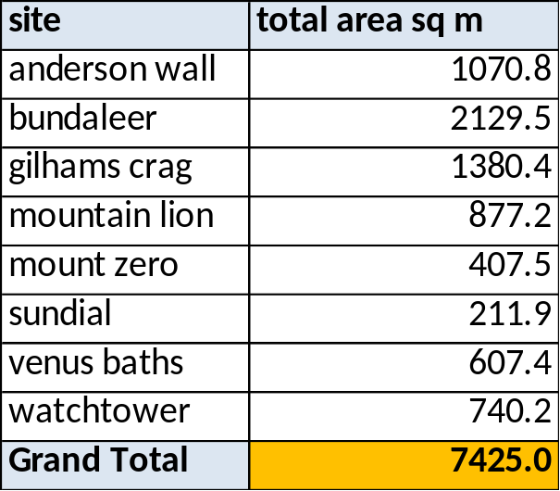

Slide 10
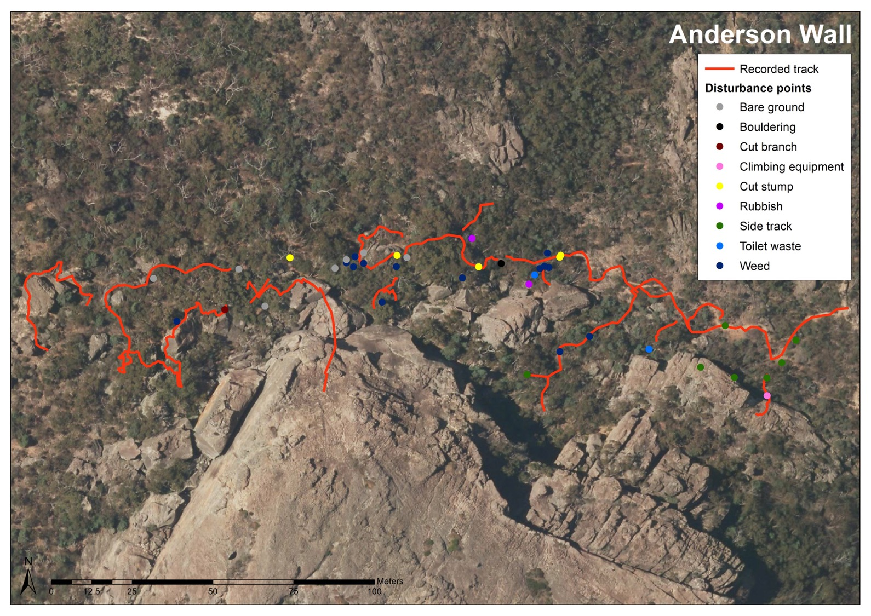

Slide 11
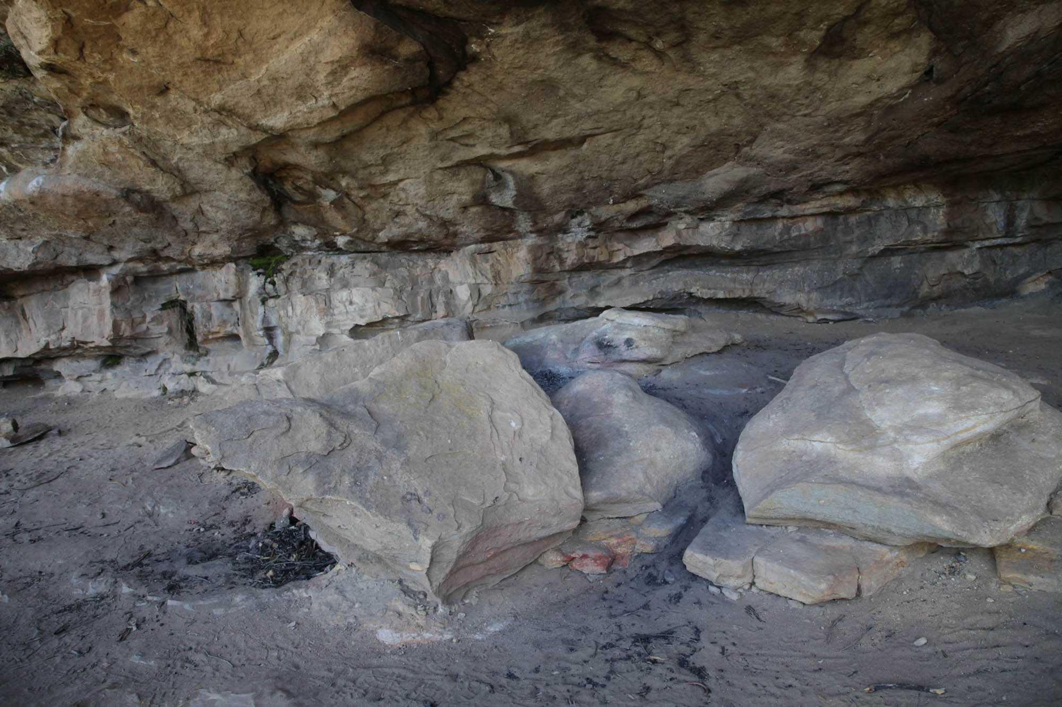
Constructed fire

Slide 12
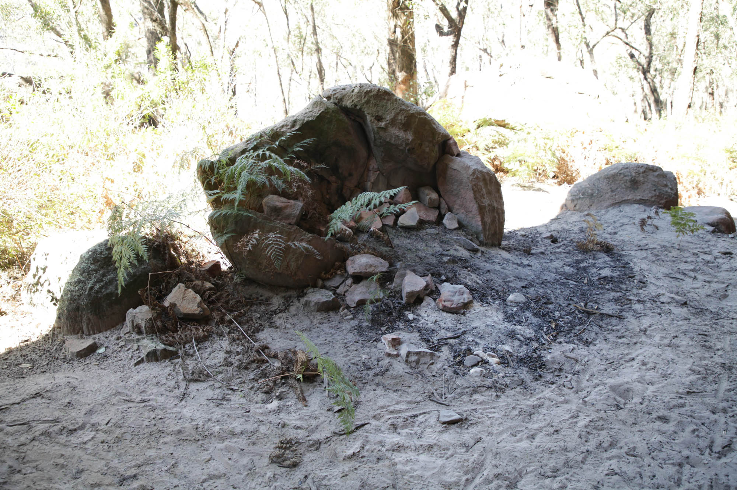

Slide 13
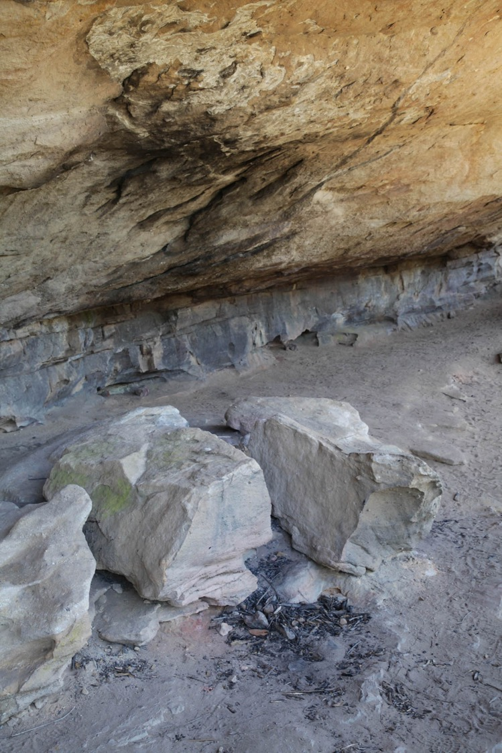

Slide 14
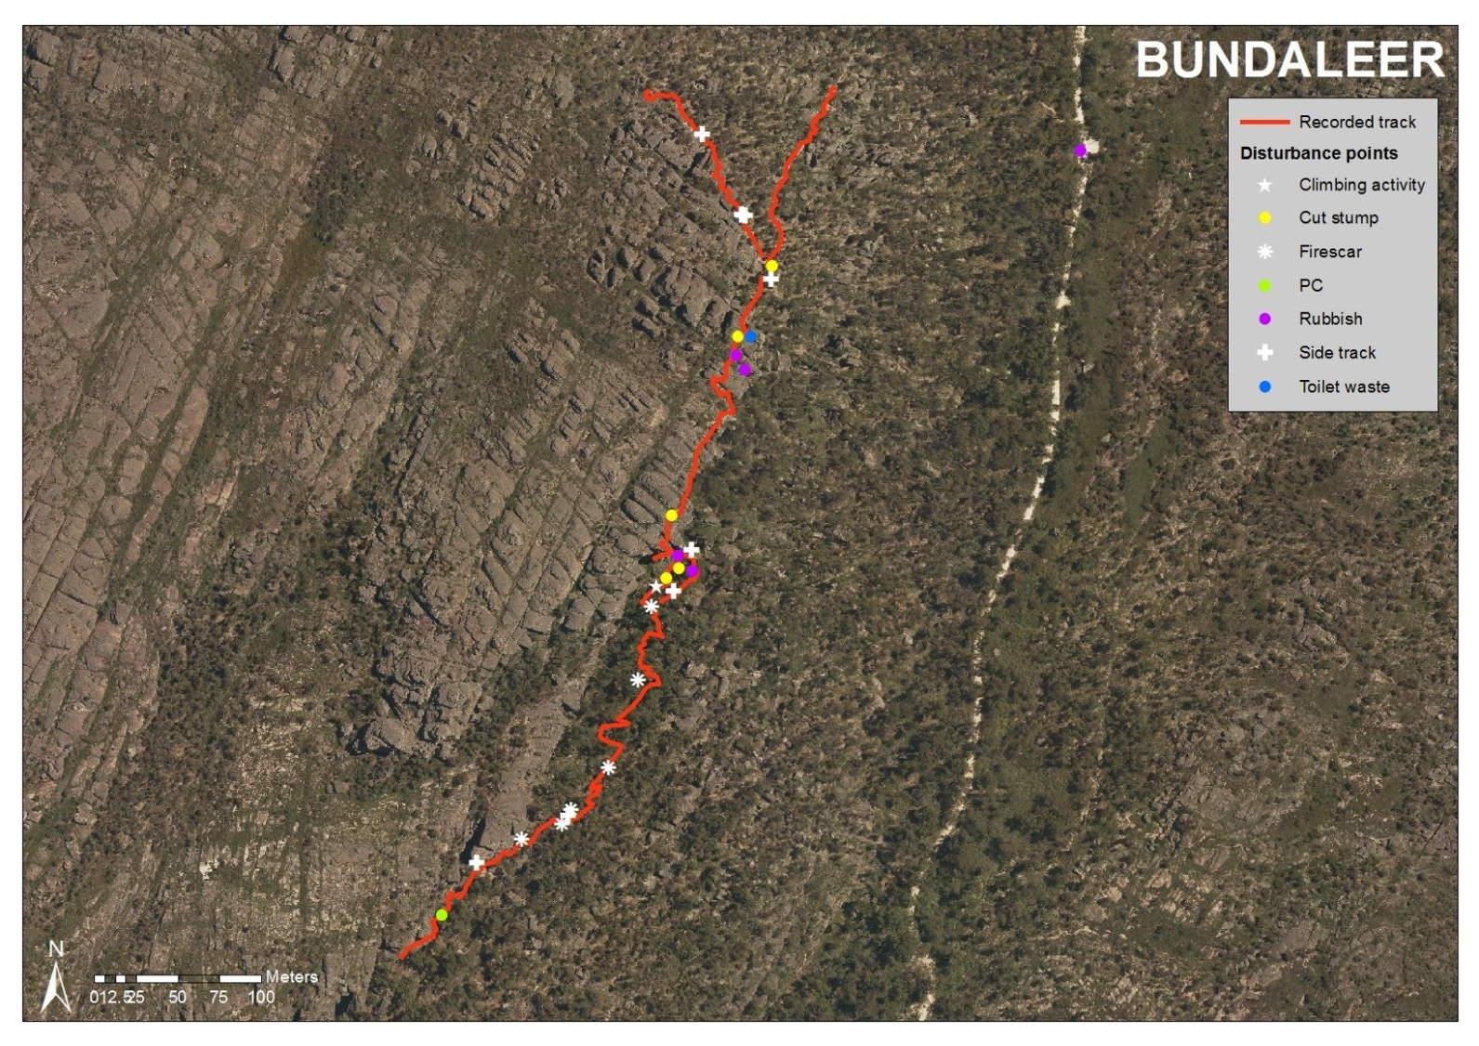

Slide 15
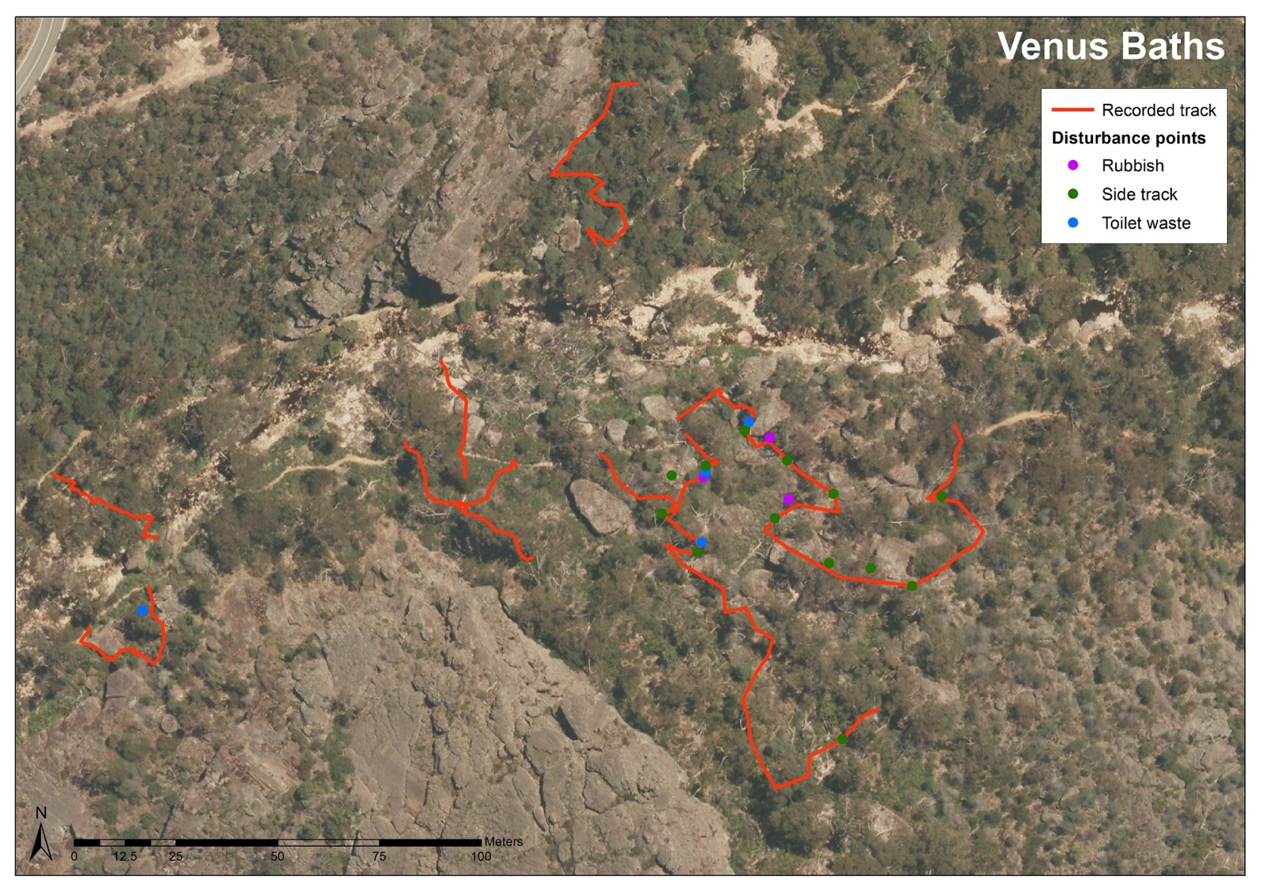
Toilet
waste and
rubbish

Slide 16
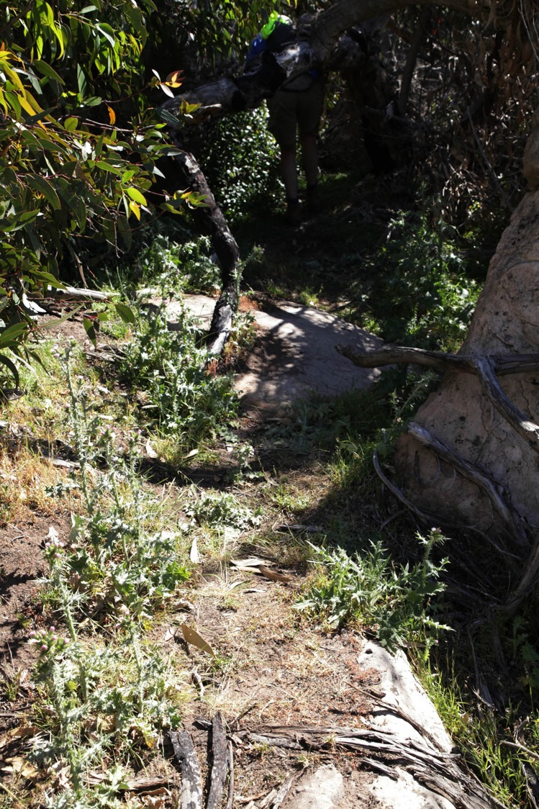
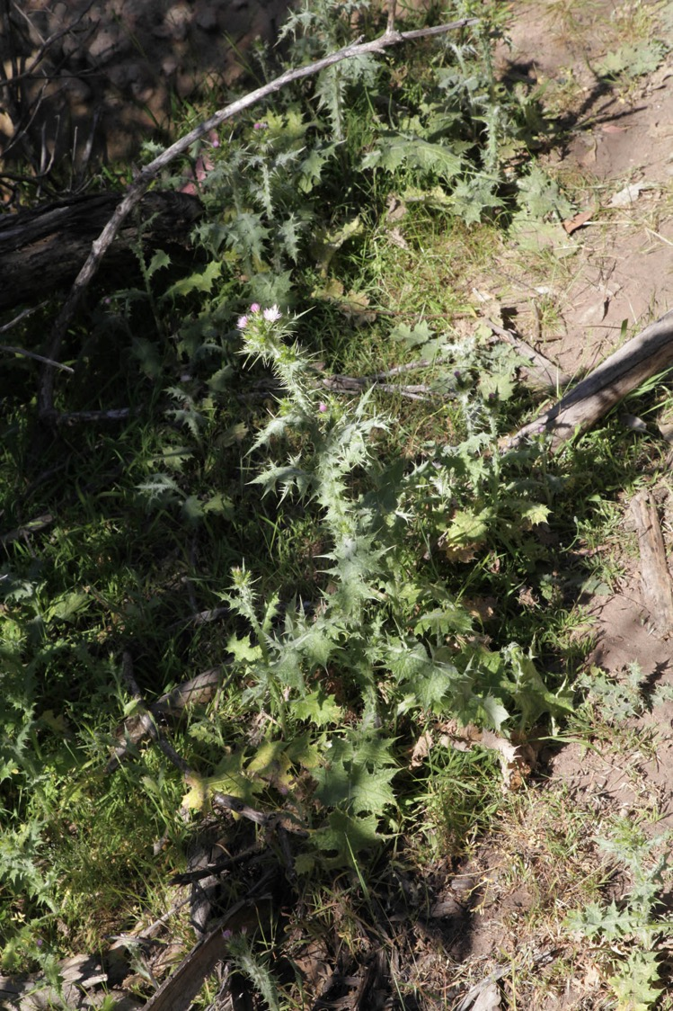
Weeds:
Thistle
Oats
Capeweed

Slide 17
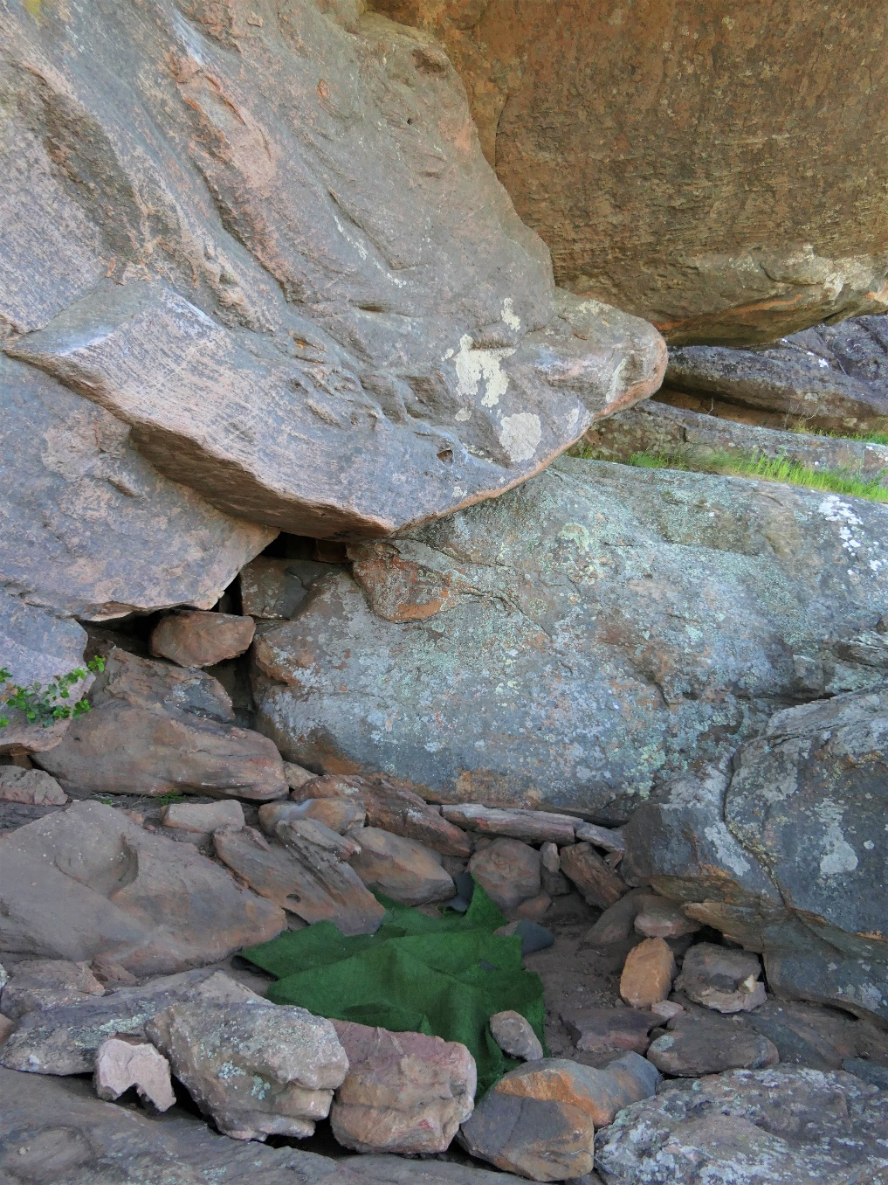
Rock works
and cairns

Slide 18
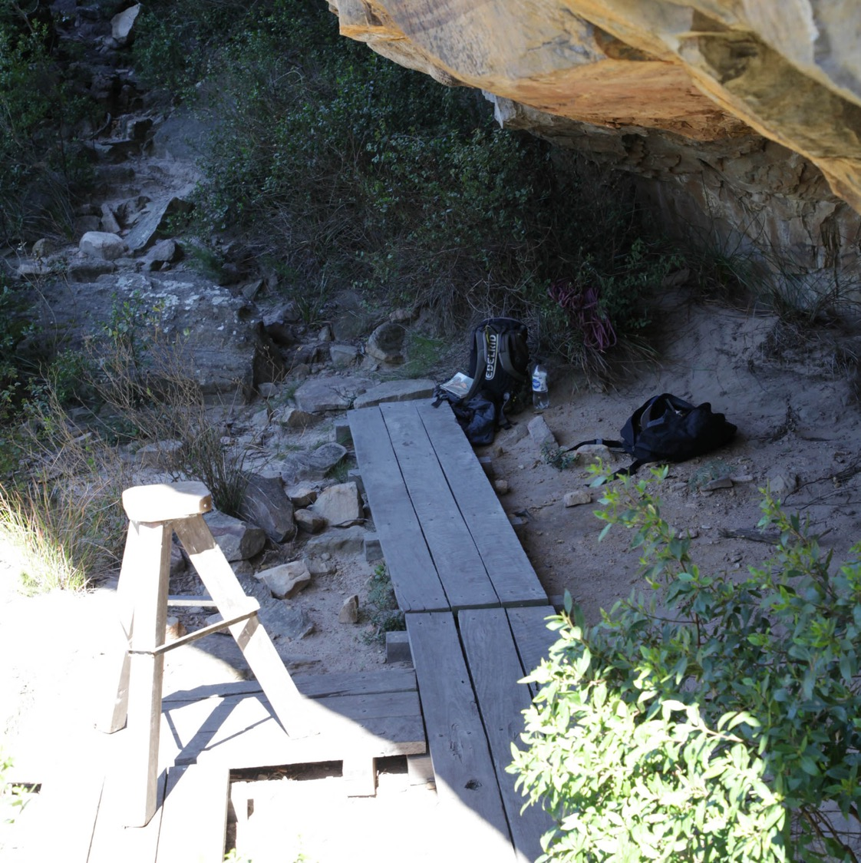
Climbing
equipment

Slide 19
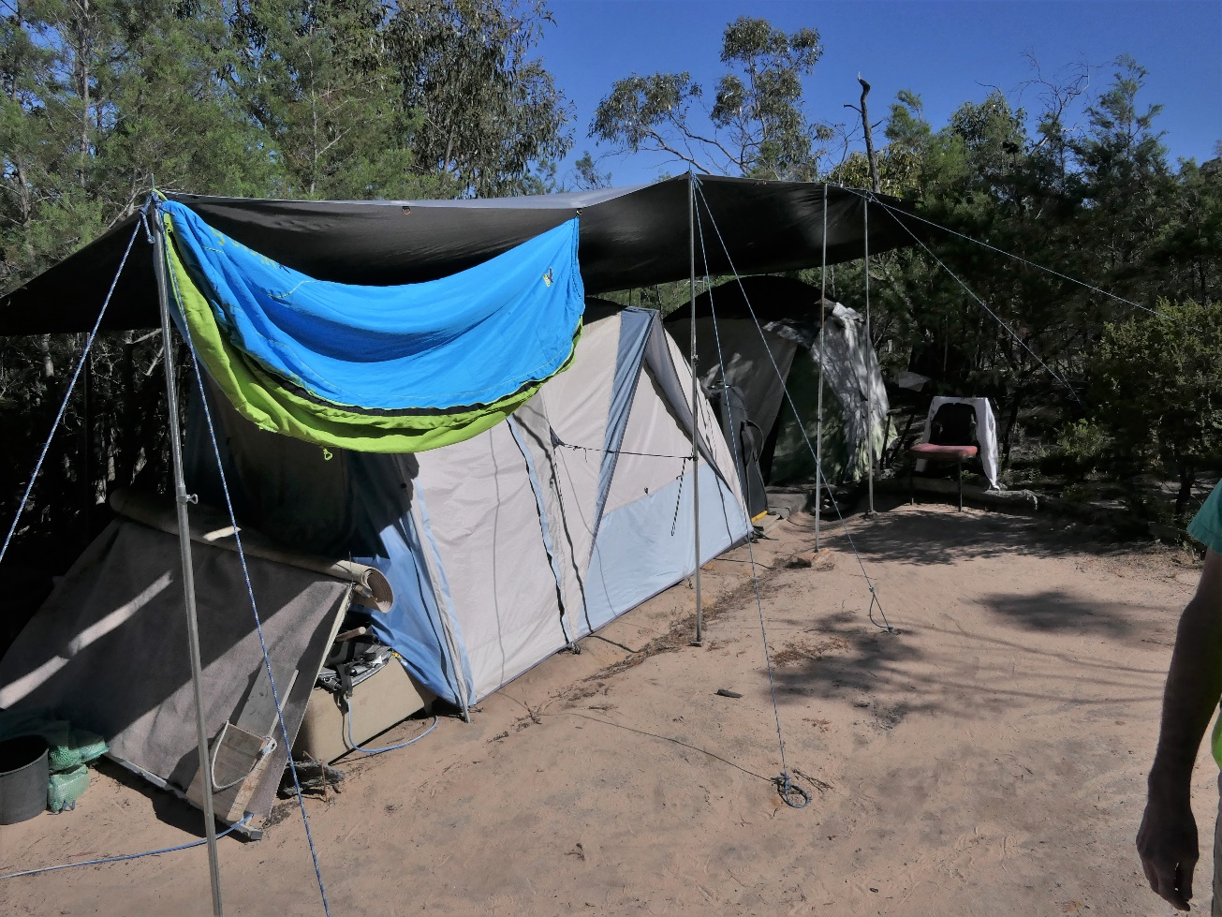
Camping equipment

Slide 20
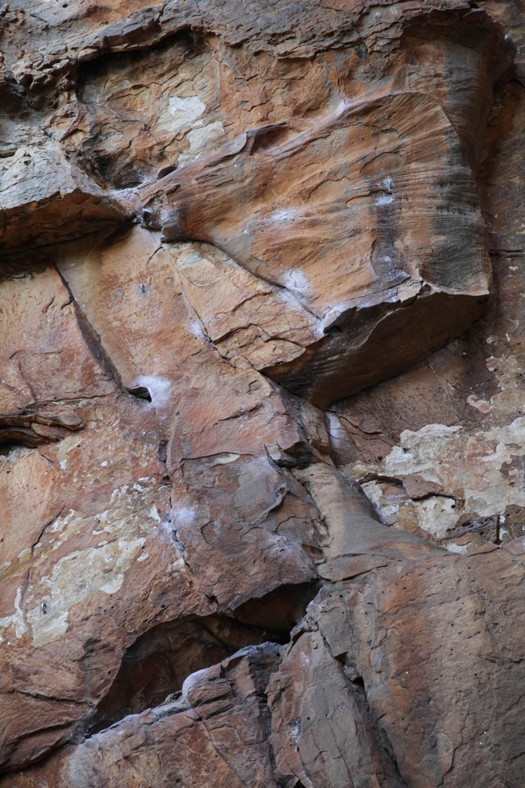
Evidence of
climbing

Slide 21
Evidence of
bouldering

Slide 22
Evidence of
bouldering
impacts

Slide 23
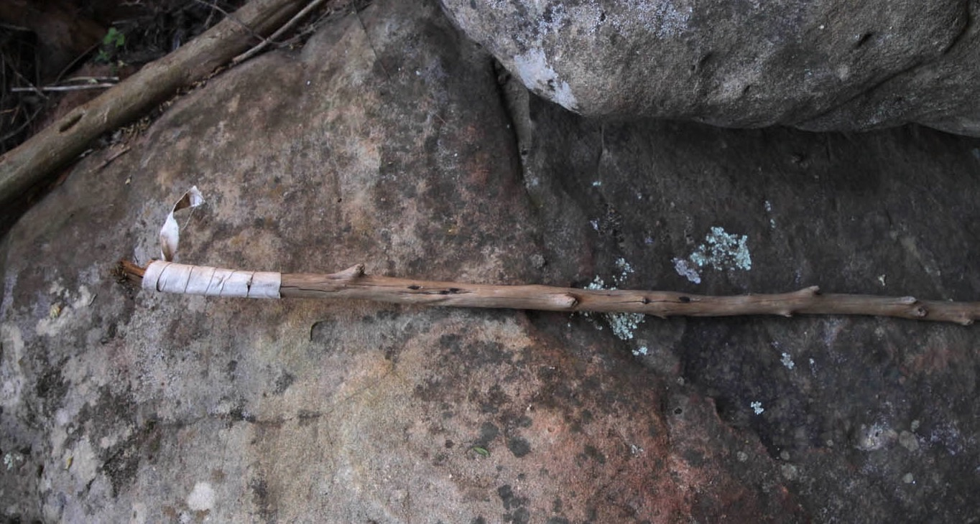
Evidence of
bouldering
impacts

Slide 24
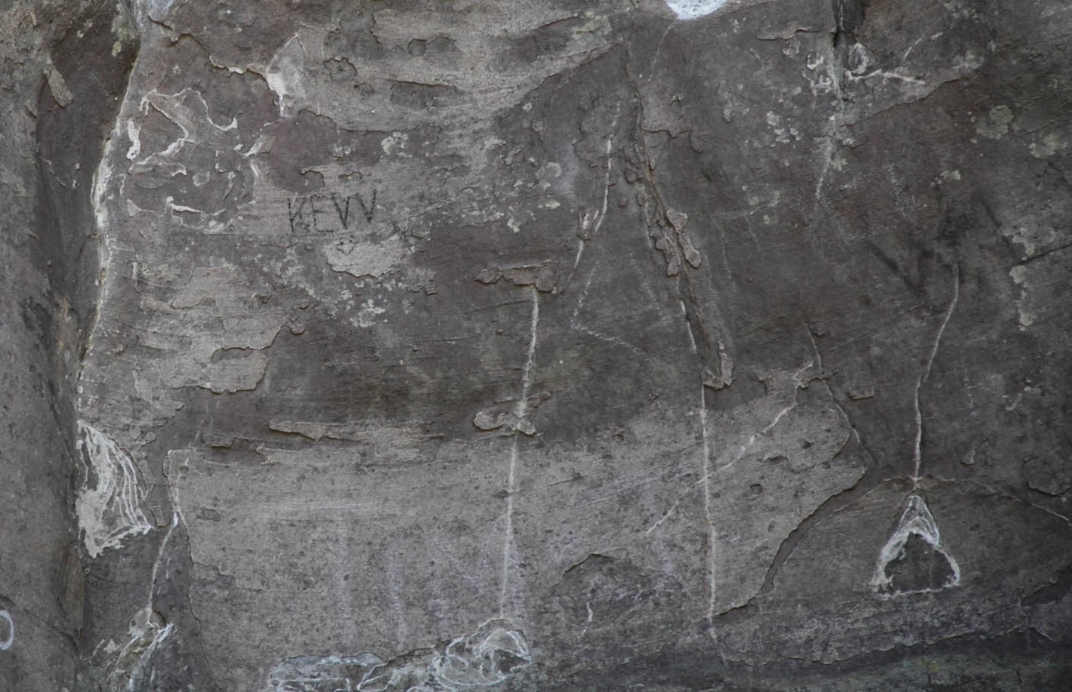
Other
impacts

Slide 25
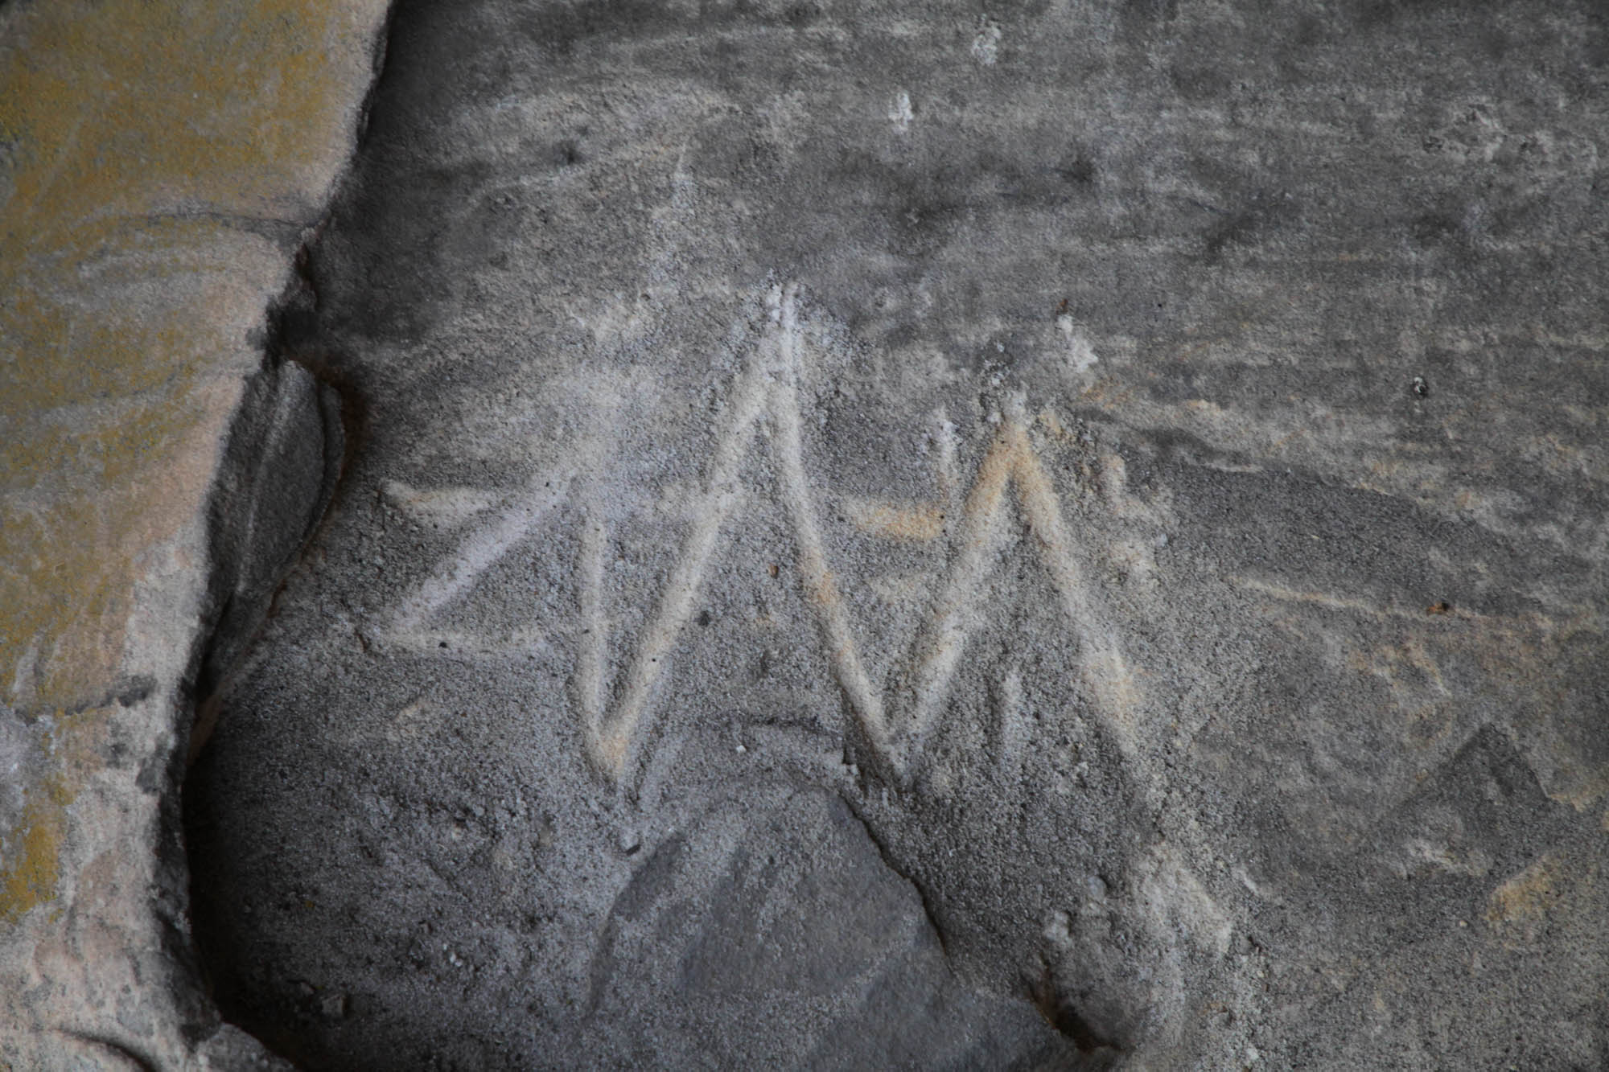
Other
impacts

