Slide 1
The conflict of Aboriginal Cultural sites and rock climbing in Gariwerd
R.G. Gunn 2019

Slide 2
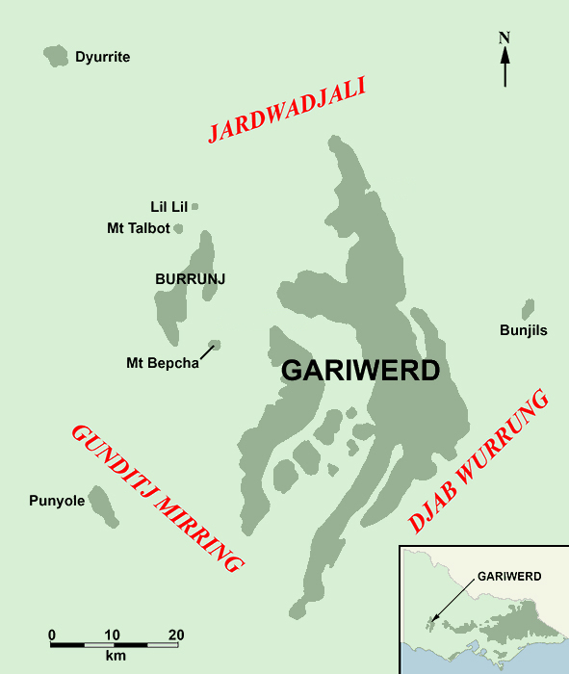
GARIWERD ROCK ART REGION
Rock art within these places
is linked through a common
art style or mythology

Slide 3
“All Aboriginal cultural heritage is protected under the Aboriginal Heritage Act 2006.
A ‘high impact activity’, as defined in the Aboriginal Heritage Regulations 2018, within an ‘area of cultural heritage sensitivity’
requires an approved cultural heritage management plan prior to the commencement of works.”

Slide 4
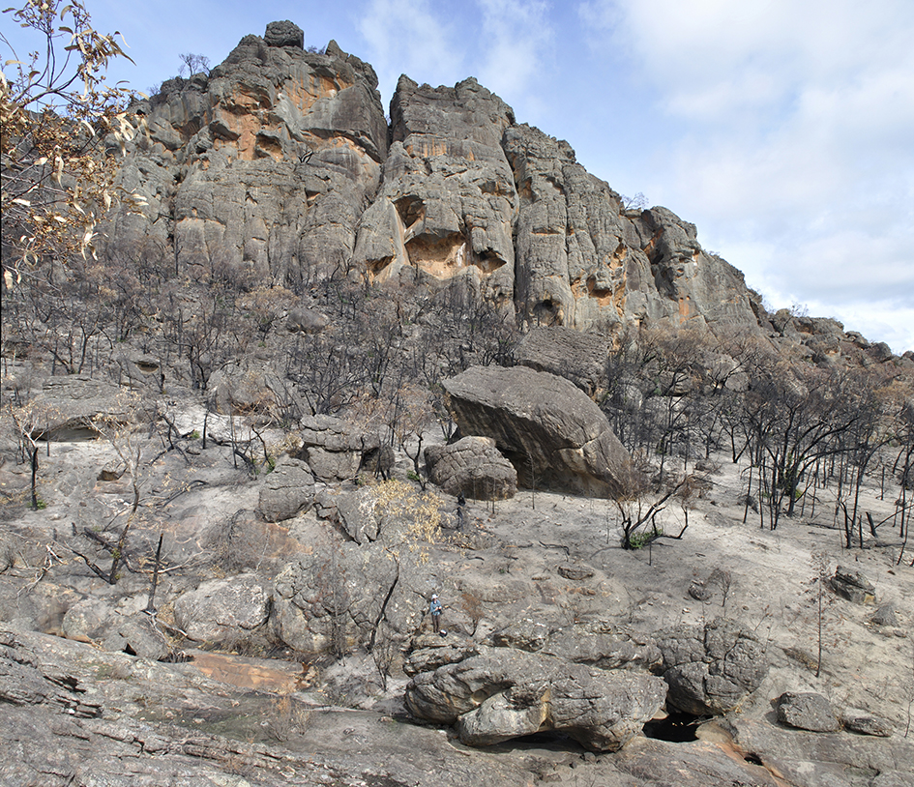
Rock shelter sites:
Archaeological
and
Aboriginal

Slide 5
MANAGEMENT PROBLEM
Due to age and weathering the rock art
in Gariwerd is, in many instances,
now very difficult to see or recognise
= much damage is inadvertent

Slide 6
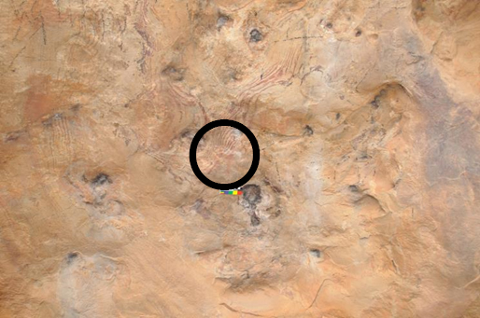
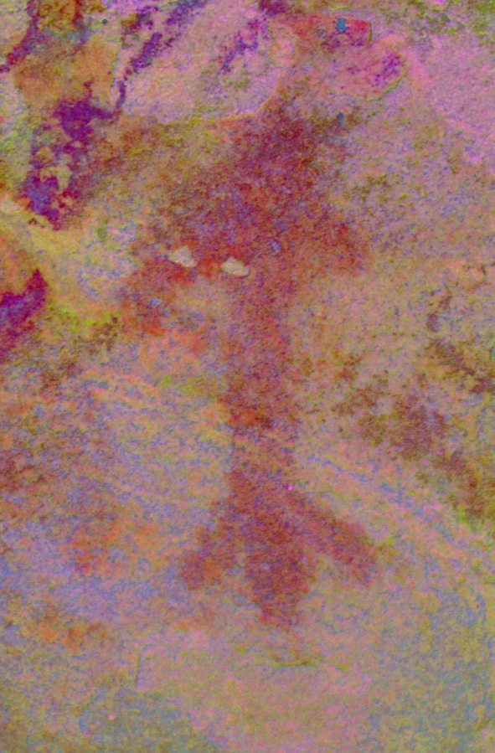
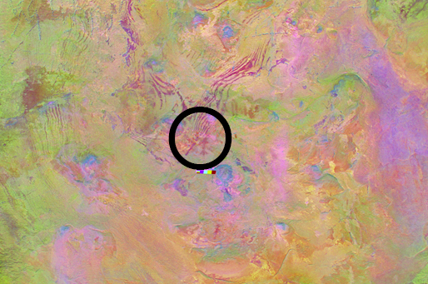
Flash
Dstretch_crgb10

Slide 7
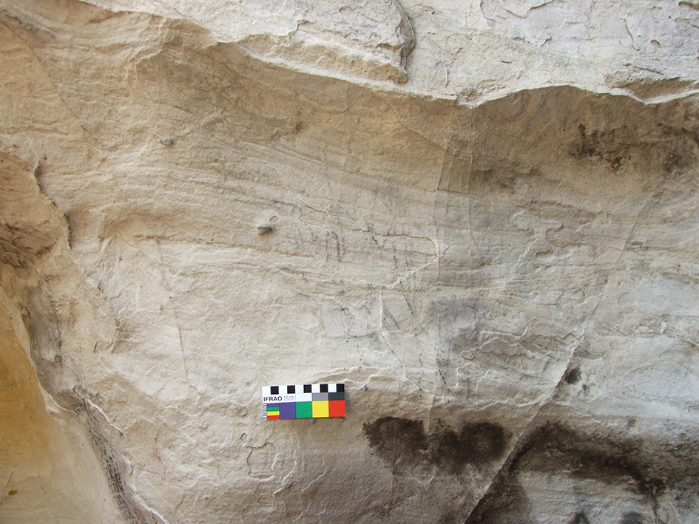
…can be mistaken for graffiti…

Slide 8
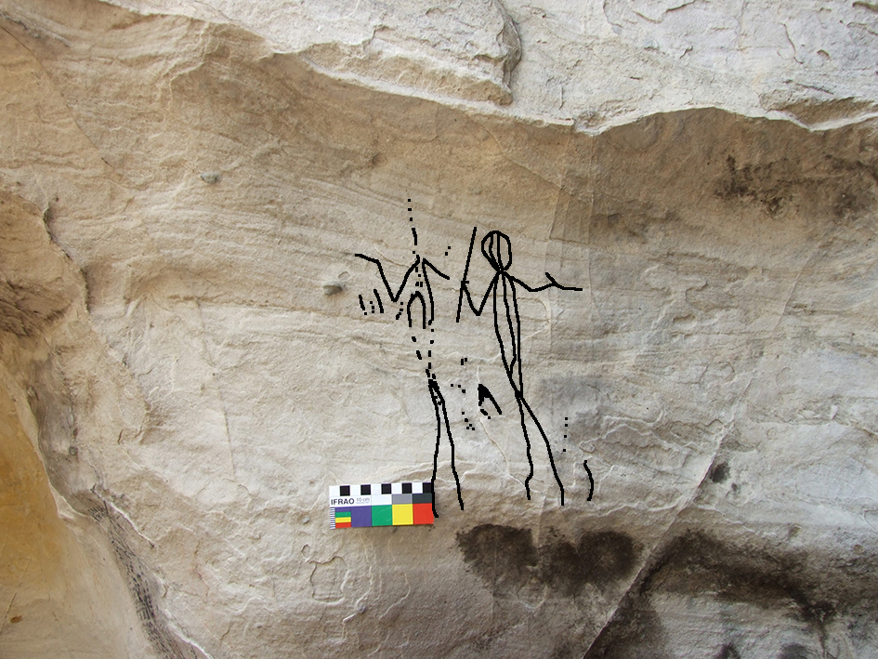

Slide 9
Abrading + scratching
Scratched
outline

Slide 10
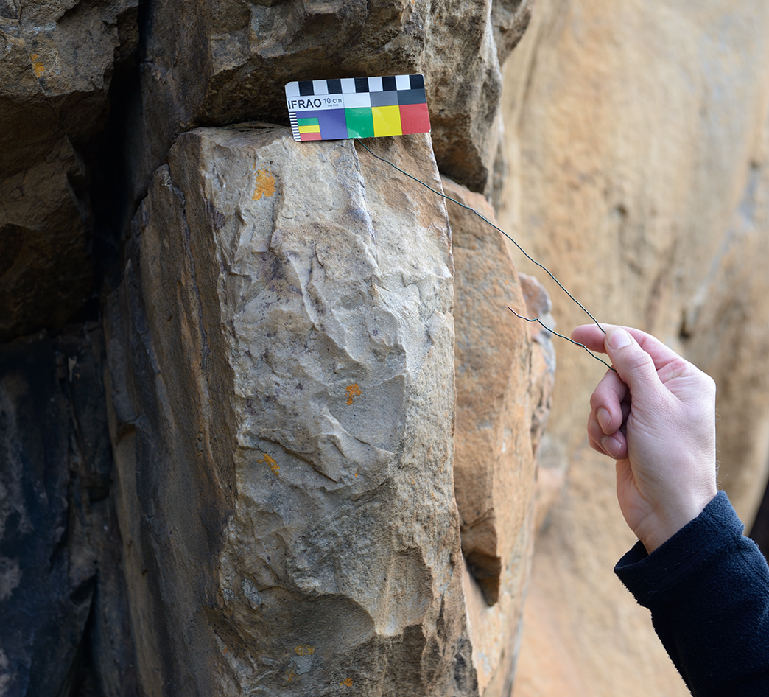
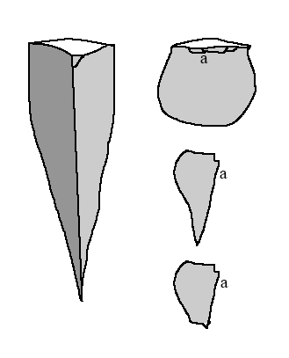
Wall flaking
– quarrying

Slide 11
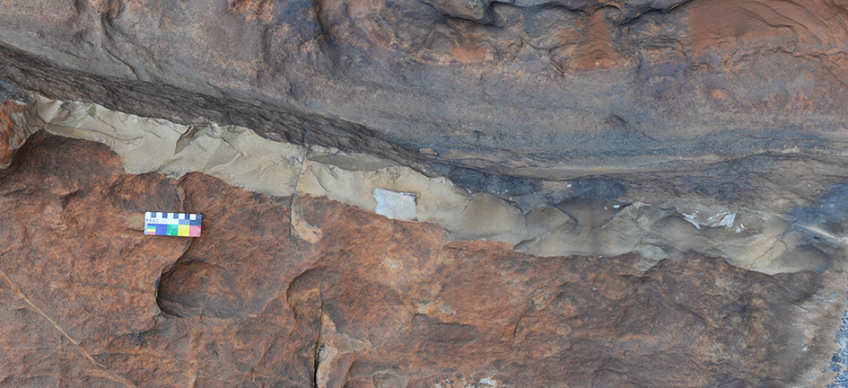
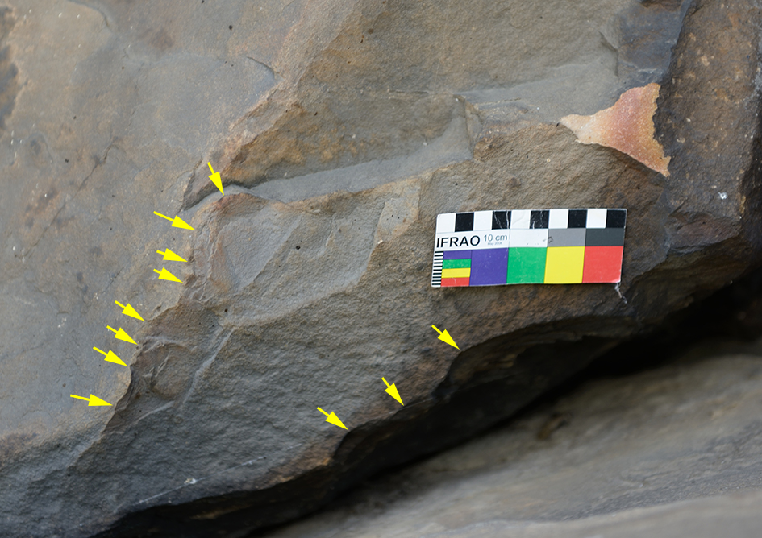
Flaking mostly along ledges
but also on inconspicuous corners

Slide 12
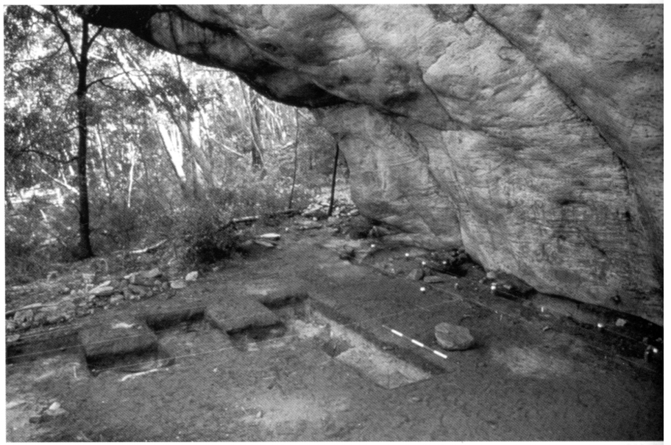
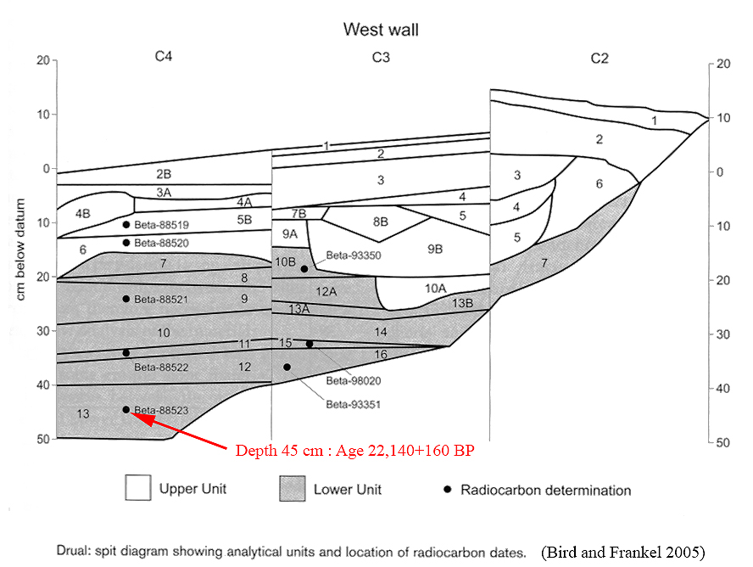
Floor deposits
Even shallow deposits may contain
valuable archaeological information

Slide 13
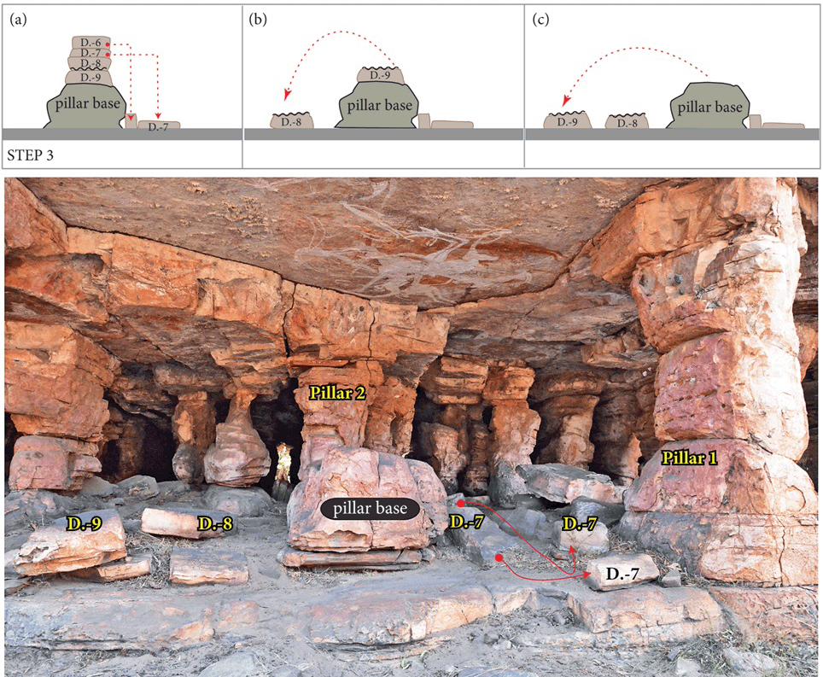
Some rock shelters have been culturally modified (Delannoy et al. 2018).
Such studies have yet to be undertaken within Gariwerd.

Slide 14
MANAGEMENT PROBLEMS

Slide 15
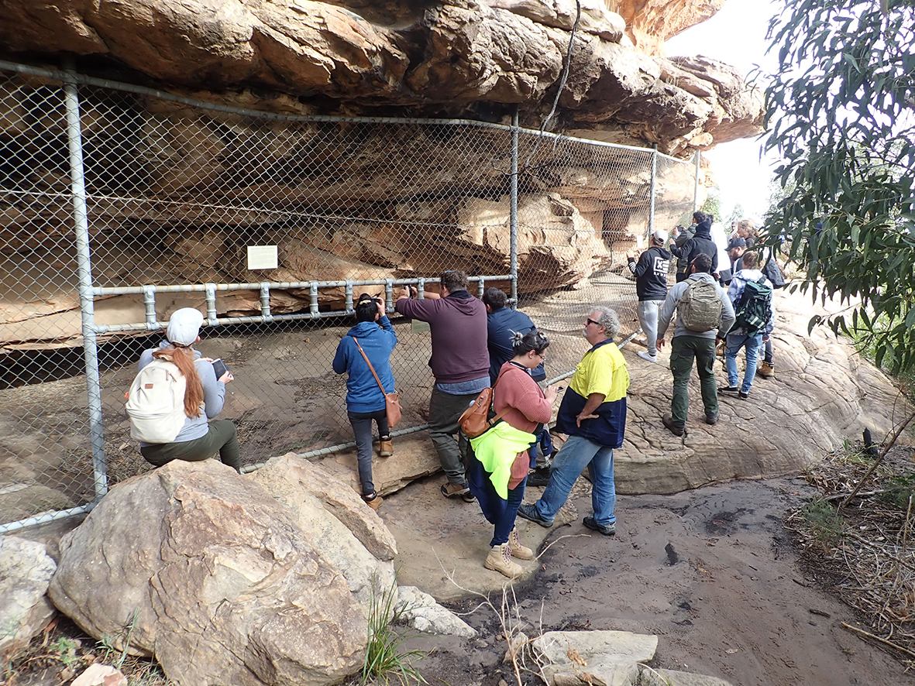
– this is not the preferred option

Slide 16
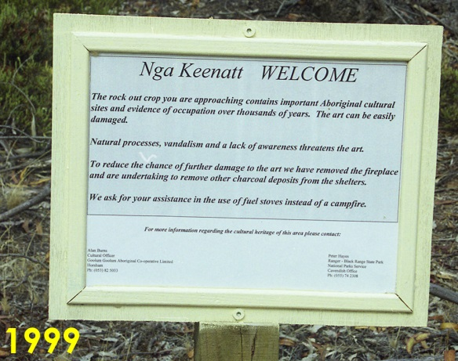

Slide 17
The escalation of bolting has occurred despite
signage informing the public of the presence of Aboriginal cultural sites and requesting climbers refrain from graffiti and bolting;
‘The Crag’, a widely-used online climbers platform, highlights the Aboriginal cultural values of the Red Rock Reserve and requests that climbers refrain from all bolting, and also from camping and bouldering in the ‘camping cave’.
The ‘camping cave’ referred to is the
Aboriginal art and quarry site LL-01 (VAHR 7323-003).

Slide 18
Dstretch_yrd10
Established climb (with bolts)
noticed in 2015 -
less than 1m from faint rock art.

Slide 19
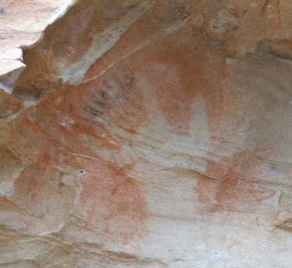
O
Bolt holes within the BR-04 shelter made in 2017 -
the climb is within 1m of clearly visible hand stencil

Slide 20
Camping in rock shelters
A: disturbed floor deposits B: increased raised dust C: fires, charcoal and wood removal

Slide 21
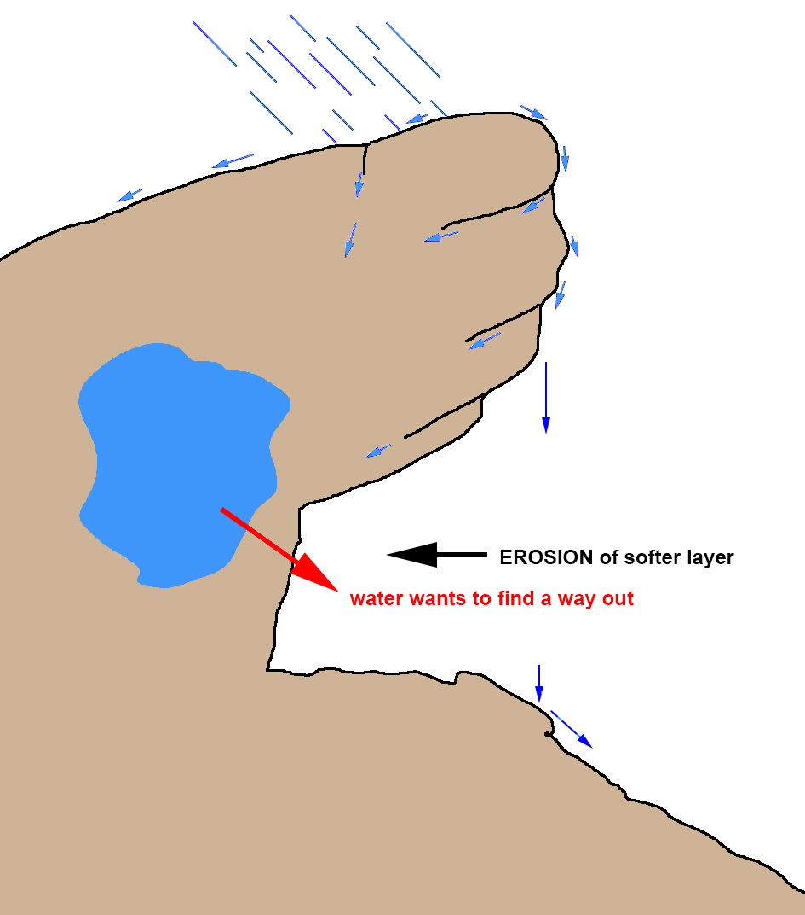

Slide 22
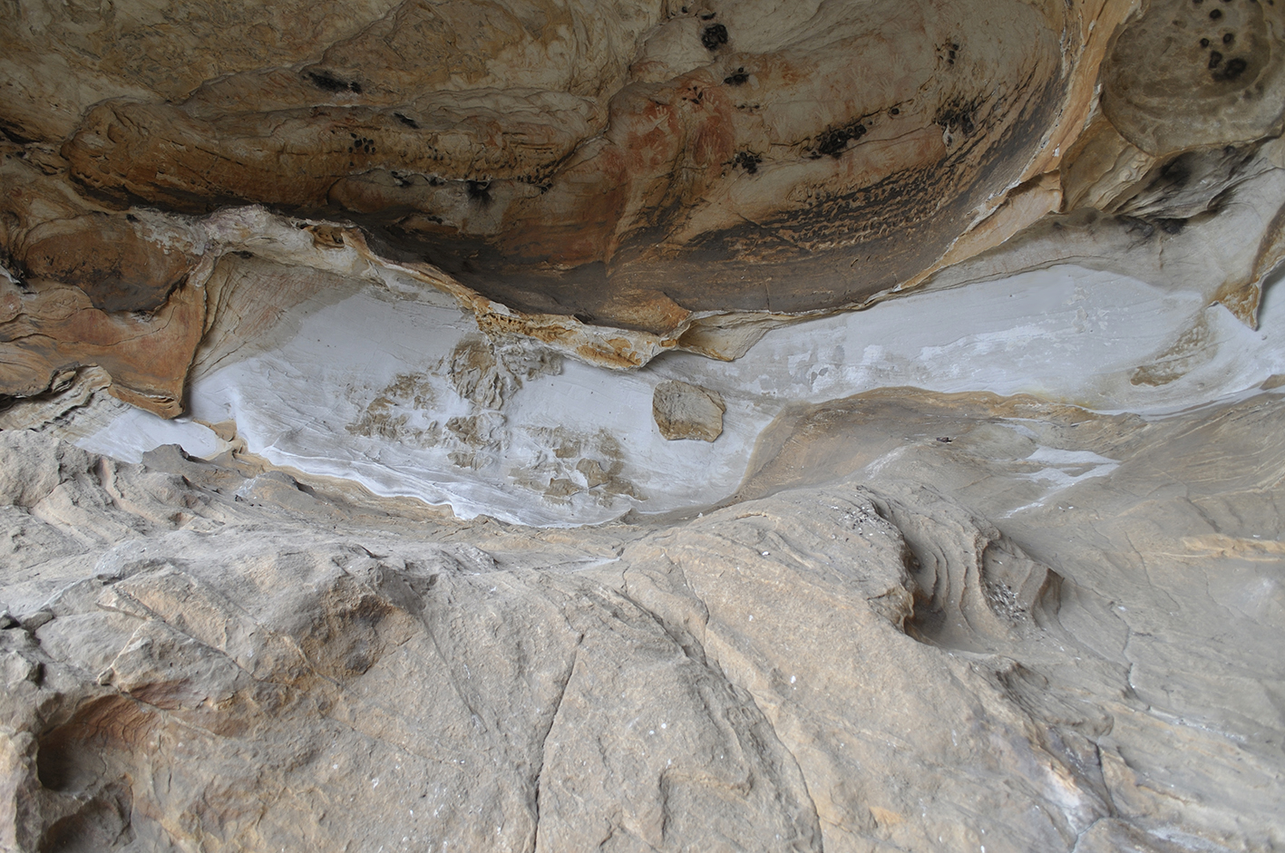
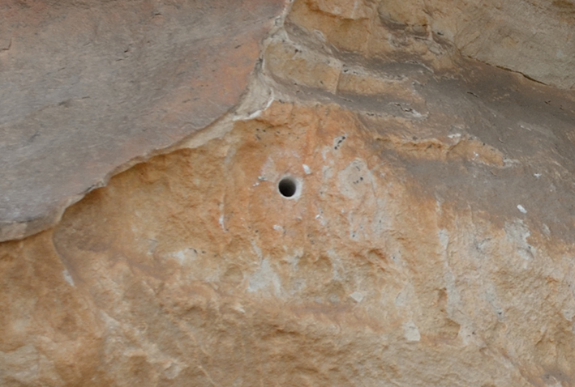

Slide 23
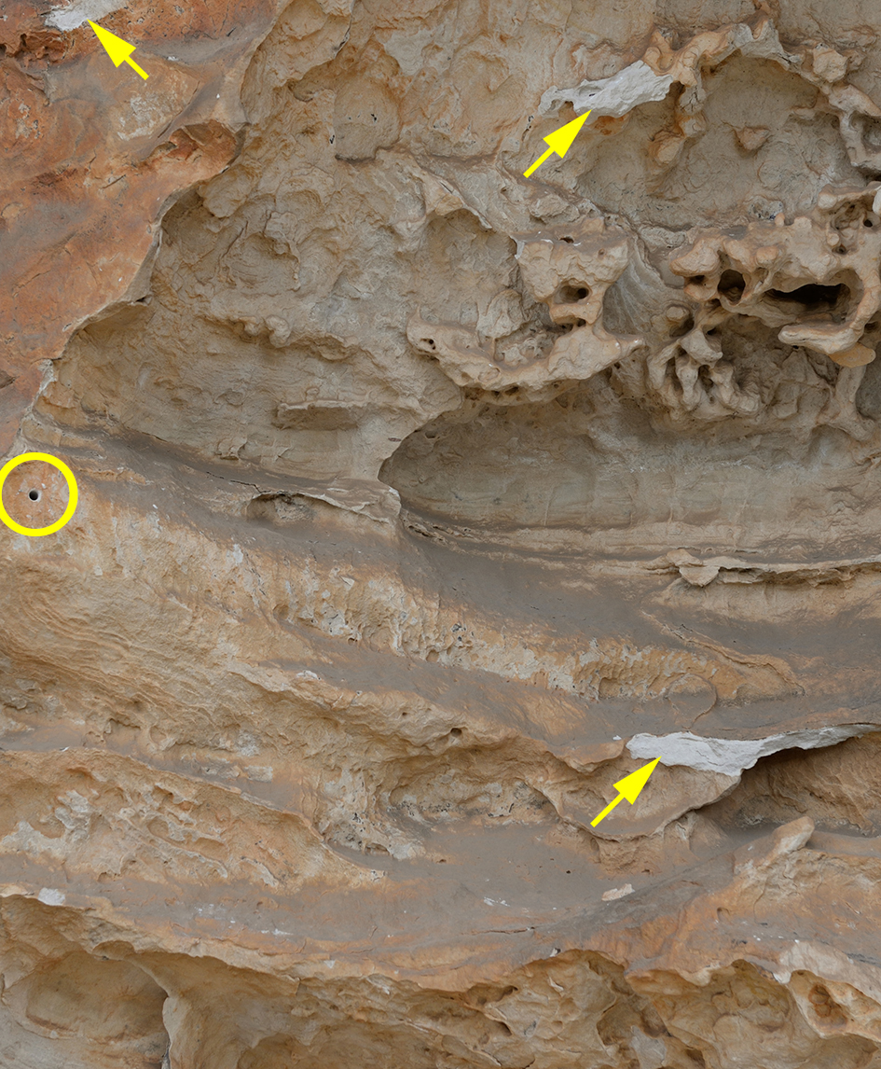
Broken
rock ledges

Slide 24
VICTORIA RANGE

Slide 25
Wall Flaking = quarry site

Slide 26
Graffiti are markings done on
private or government property
without formal or tacit consent
and, hence, not endorsed by the
broader society
(cf. Keegan 2014:4-5).
Chalking is graffiti
and hence an offense under the
Aboriginal Heritage Act 2006

Slide 27
SITE | chalk | breakage | Disturbed deposit
FR-01 | x | x
FR-02
FR-03
FR-04 | x
PT-01
Ngam
BC-01
GC-01
GC-03 | x | x
BAR-02a | x |  | x
BAR-02b | x |  | x
PLAN a | x
PLAN b | x |  | x
PLAN c
BELL
Assessment of art sites
within Special Protection Areas
to date:
Damage attributed to climbing

Slide 28
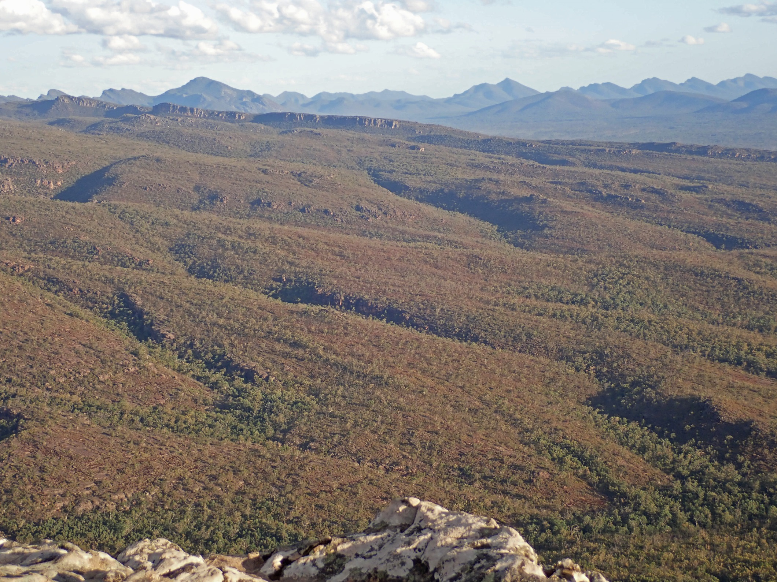
THANK YOU

